Slide 1
NIFTY50 FORECAST
Delera Giacomo Howe Alessandro
Barbo Cyril
2024-2025

Slide 2
Dataset Description
Source: Historical NIFTY50 data from [Kaggle]
Time Period: January 2017 – December 2022
Features:
Date
Open, High, Low, Close prices
Volume traded
Additional Data:
Other major indices: S&P 500, Nikkei 225, FTSE 100 for correlation analysis
Frequency: Minute/Daily observations

Slide 3
Objective of the study
Main Goal: Forecast future movements of the NIFTY50 index
Secondary Goal:
Analyze and quantify correlations between NIFTY50 and global market indices
Understand how global trends affect Indian market behavior
Approach:
Time series forecasting using Linear Regression and ARCH models
Correlation matrices for inter-index relationships

Slide 4
Linear Models Forecast
Model: Linear regression and ARMA
Features Used: Previous day’s returns, lag values, moving averages
Result:
R² Score:
Residual Analysis indicates weak autocorrelation
Observation:
Good for capturing trend, Residuals not Guassian
immagine
immagine

Slide 5
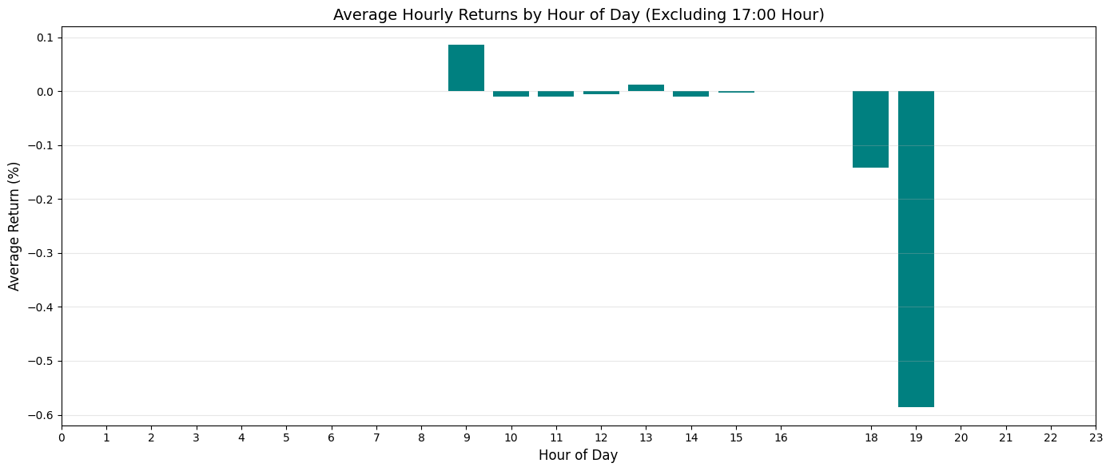
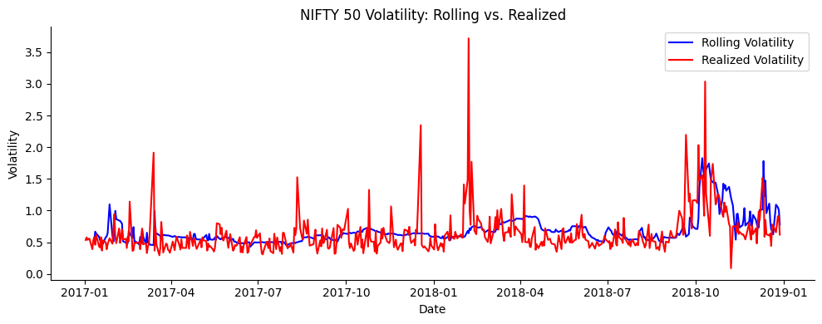
Modelling volatility with GARCH
Model: GARCH (Autoregressive Conditional Heteroskedasticity) on 2017-2018 data
Purpose: Capture volatility clustering in financial time series
Daily log-returns
Hour 17.00 returns are excluded
ADF tests (under all the 3 assumptions) show that there is statistical evidence to assume stationarity
Result:
Significant ARCH effect (confirmed via LM test)
Low R^2 and adjusted R^2
Prediction: 1 step-ahead rolling window

Slide 6
Correlation Analysis with Global Indices
Indices Analyzed: S&P 500, Dow Jones, Nikkei 225, FTSE 100
Method: Pearson Correlation of daily returns
Result:
Highest correlation: S&P 500 (e.g., 0.78)
Moderate correlation with Nikkei and FTSE
Implication: NIFTY50 is highly sensitive to U.S. market movements
immagine

